Slide 1
Psychographic Segmentation

Slide 2
Strategy – Mobile Phone Brand
Response 1, 2, 4, 5, 6, 8, 15 & mobile phone brand.
8 principal components based on 8 above columns.
Correlation of each column with principal components.
6 which explained 85% of total variance.
Response 4, 15, 8 has highest correlation with PCs.
Clustering with 4, 15, 8 and mobile brand.
K = 3
We concatenate cluster labels with rest of the dataset & check validity & reliability.

Slide 3
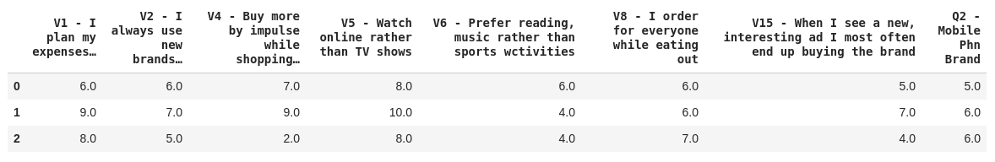
Strategy – Mobile Phone Brand
Response 1, 2, 4, 5, 6, 8, 15 & mobile phone brand.
8 principal components based on 8 above columns.
Correlation of each column with principal components.
6 which explained 85% of total variance.
Response 4, 15, 8 has highest correlation with PCs.
Clustering with 4, 15, 8 and mobile brand.
K = 3
We concatenate cluster labels with rest of the dataset & check validity & reliability.
Cluster Characteristics

Slide 4
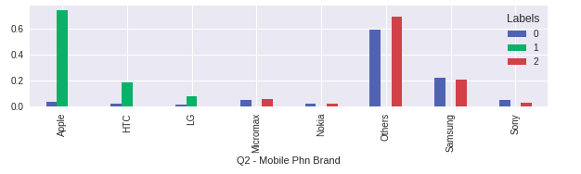
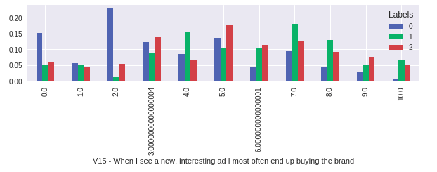

Slide 5
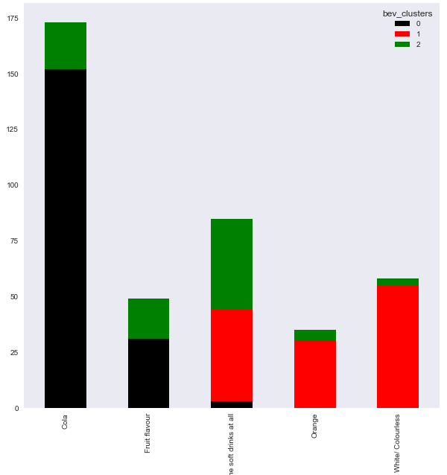
Strategy – Cold Beverages
Response 2, 3, 4, 6, 7, 9, 15 & Soft Drink.
K Means Clustering has been done on the above Responses using K = 3.
K = 3 has been considered because it is has a reasonable Silhouette Score compared to other values of K.
Cluster Characteristics:
Clusters | Characteristics
Cluster 1 | Majority of the respondents are cola or Fruit Flavor drinkers.
Cluster 2 | Majority of the respondents either drink Orange or White/Colorless Beverages.
Cluster 3 | Majority of the respondents are Fruit Flavors Drinkers or non consumers of Beverages.

Slide 6
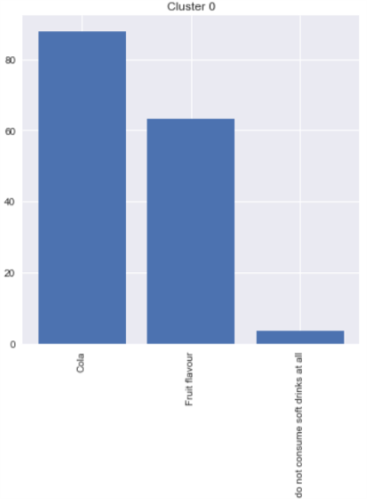
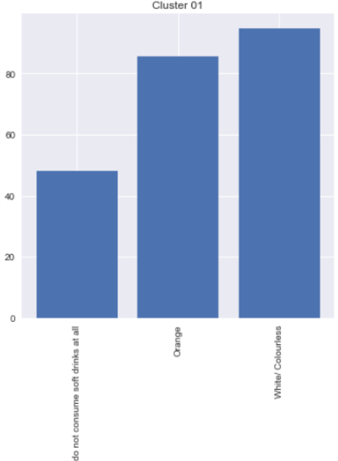
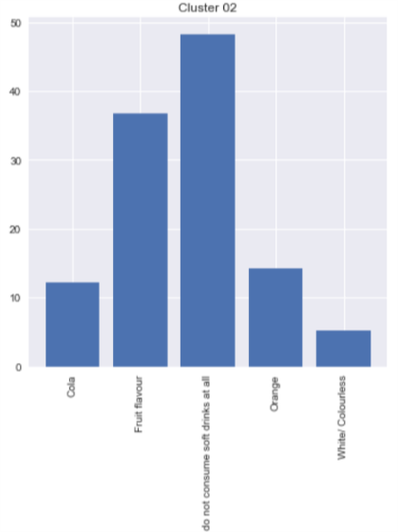
Questions | Mean
 | Cluster 0 | Cluster 1 | Cluster 2
2 - I always use new brands… | 5.75 | 5.41 | 3.78
4 - Buy more by impulse while shopping… | 6.52 | 6.67 | 2.72
15 - When I see a new, interesting ad I most often end up buying the brand | 5.43 | 5.09 | 2.51
3 - Weekends at home with family… | 5.82 | 6.59 | 7.08
6 - Prefer reading, music rather than sports activities | 5.48 | 5.58 | 3.19
7 - Watch movies in first few days of release | 5.49 | 4.46 | 2.02
9 - Some physical exercise everyday | 4.55 | 5.52 | 6.43

Slide 7
THANK YOU
Divyojyoti
Sutrishna
Dwaipayan
Pritam
Jeeru Nitish

